Slide 1


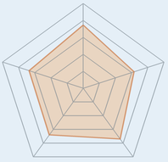



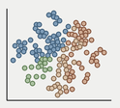
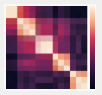




(a) Stage 1: Baseline Initialization
(Age 10)
(b) Stage 2: Iterative Experience
Evolution (Age 10 → 25)
(c) Stage 3: Longitudinal
Evaluation & Analysis (Age 25)
Agent Persona & Traits
Continuous Experience Injection
Final Assessment
(Age 25)
(Age 10)
Final Assessment (T25)
Innate
Traits
Personal
Background
Maturity
Study
Socializing
Daily
Life
Milestones
Challenges
Maturity
Social
Learned
Skills
Social
Context
Behavior
Emotion
Iterative Experience-
Driven Evolution
Final Assessment (T25)
(Age 10 to 25)
Longitudinal & Population Analysis
1. Pre-Post Comparison (Δ = T25 - T10)
Baseline Assessment (T10)
Age 10 → 11 → 12 → … → 24 → 25
Maturity
LLM-based State Evolution
& Internalization
2. Population Dispersion
Internalize → Reflect → Grow
Social
Emotion
Feedback
Loop
Behavior
Cognition
Cognition
& Memory
Population
Dispersion
Pairwise Similarity
& Preservation
Multi-dimensional
Baseline Assessment
Internalize → Reflect → Grow
LLM-based State Evolution
Longitudinal & Population Analysis
Notes:
Recreated from the supplied reference infographic.

